Slide 1
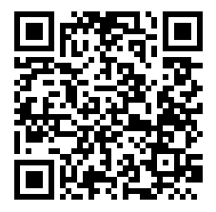
HackPSU 2019:
HackBot!
Adam Steinberg, Carson McCaffrey, Fatih Celep

Slide 2
What are APIs?
Application Programming Interface
Gives users the ability to utilize other programs/features in their own projects
Why build your own when it already exists!
Oftentimes utilizes JSON or XML formats
Popular APIs: Google Maps, Youtube
Useful for accessing info stored elsewhere to reduce processing costs
Notes:
Fatih

Slide 3
What is the Python Requests Library?
The requests library is the easiest way of making HTTP requests in python
Simple- little to no setup for most requests
Readable- understandable with a glance
JSON responses are parsable and reusable
Send get requests to APIs in order to receive data you don’t have direct access to
Send post requests to APIs in order to automate sending data to a service
Notes:
Fatih

Slide 4
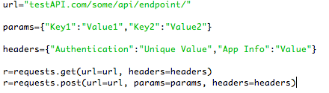
Example Call to API Using Requests
Notes:
Fatih

Slide 5
What can we use this for?
We can use the request library, in combination with APIs in order to:
GET messages from a chat
We can parse these messages to determine if there is action we should take
GET information from other APIs
POST a message to the chat
Use info from the chat messages or from other APIs in order to create whatever message you want
Notes:
Fatih

Slide 6

Let’s Make A Bot
Notes:
Carson

Slide 7
Fork or Download Github Repository
https://github.com/AdamMSteinberg/TestBot
If you download the files instead of forking make sure you push the files to your own github account
Notes:
Carson

Slide 8
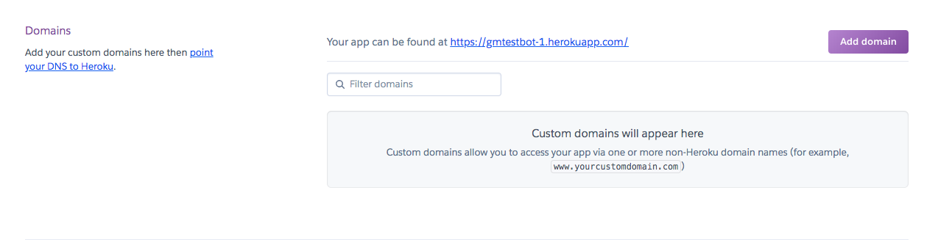
Make Heroku Account
https://signup.heroku.com/
Once logged in, Create a new app (all lowercase, must be unique)
When your app is created, navigate to the “Deploy” tab and select GitHub as the deployment method.
Make sure you select the correct branch to build your app from (search for repo)
You can set up automatic builds from that repo so you never have to worry about your bot being up to date
MAKE SURE YOU HIT DEPLOY
Copy Callback URL from Settings Tab
Notes:
Carson

Slide 9
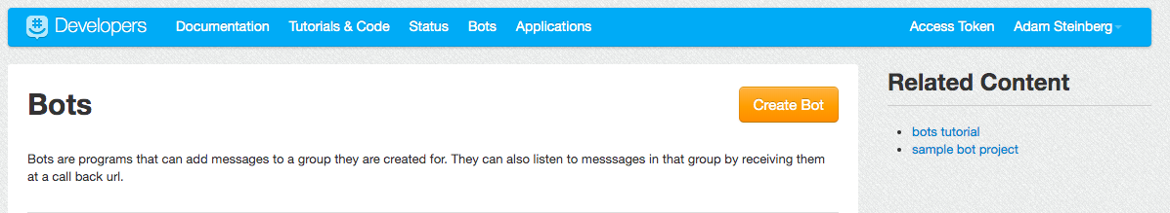
The GroupMe Bot
https://dev.groupme.com/bots
Click “Create Bot”
MAKE SURE YOU SELECT THE CORRECT GROUP TO ADD THE BOT TO. THIS CANNOT BE CHANGED
Name the bot
Use callback URL from Heroku site
Use any picture URL to give your bot an avatar
Once created, click on your bot and copy the bot ID
Notes:
Carson

Slide 10
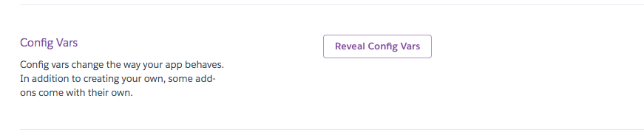
Back In Heroku
Navigate to the settings tab and click “Reveal Config Vars”
Add a variable with the key “GROUPME_BOT_ID” and the value that you copied from your bot
This allows you keep the bot ID private (off github) for security
CONGRATS!!!
You should now have a working bot
Time to make some new commands
Notes:
Carson

Slide 11
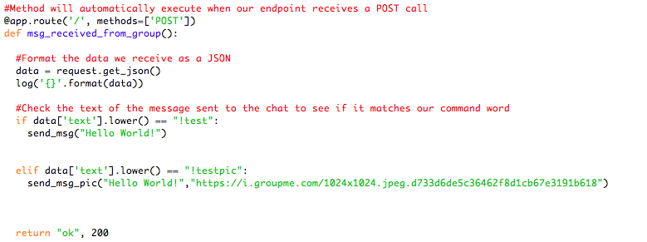
The Code
Notes:
Adam

Slide 12
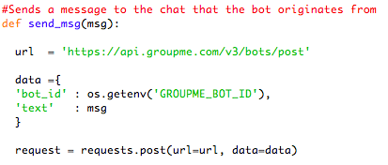
The Code
Notes:
Adam

Slide 13
Some Helpful Links
How the GroupMe API Works
https://dev.groupme.com/docs/v3#bots
Sending images NOT hosted on GroupMe
https://dev.groupme.com/docs/image_service
The Requests Library Documentation/Reference
https://3.python-requests.org/
Notes:
Adam

Slide 14
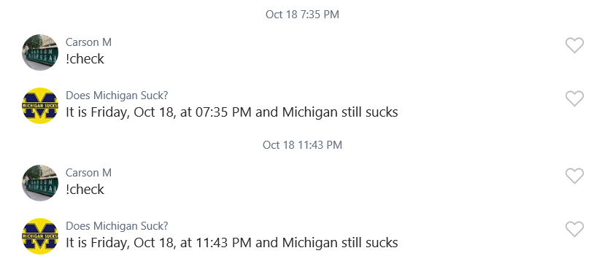
Example: Michigan Bot
Notes:
Adam

Slide 15

Some Ideas (And Challenges)
Easier:
Make the bot only respond to your messages
Make a DadBot
If someone sends a message with “i’m” in it, respond appropriately
Keep a running tally of how many times a command has been called
Harder:
Use another API to get information to send to the chat
What is the weather
Register pictures from outside of GroupMe with the GroupMe API
Ask us for help with this one, there are a few tricks
Use cameras/sensors to send live information to your chat
Collect statistics on who sends messages most often to the chat
Notes:
Adam

